Slide 1

Academic Advisement Reports 101
my.harvard System

Slide 2
Agenda
1.INTRODUCTION
2.MAINTENANCE
3.Resources
What are AARs?
How does it work?
What are the benefits?
How can I use it?
Managing AARs
  Changes to requirements
  Updates to course lists
  Timeline
HCOL Concentration Workcenter
FASRO Training Portal
AAR partners
Notes:
Links to these tutorials can be found on the Catalog Coordinator page.

Slide 3
1. Introduction: What are AARs?

Slide 4

Academic Advising Reports (AARs)
Degree Progress
Academic Advising Reports aggregate all the of Harvard College requirements in one place, to facilitate transparency in advising, course selection, and report on student progress towards degree.
Advising
Course Selection
Concentration
Declaration

Slide 5
1. Introduction: How does it work?

Slide 6
Harvard College Requirements

Slide 7
Harvard College Requirements
College Core | Concentration | Electives
10-12 courses | 10-14 courses | 8-10 courses
General Education | Fields of concentration | Secondary fields
Distribution Requirement |  | Language Citations
Quantitative Reasoning w/ Data |  | Study Abroad
Expository Writing
Language Requirement

Slide 8
1. Introduction: What are the benefits?

Slide 9

AAR Benefits
Departments, advisors, and students can track progress towards degree
Degree Eligibility
Advising
Course Registration
Reporting
Transparency
Enforces secondary field/ concentration rule

Slide 10
1. Introduction: How can I access the AARs?

Slide 11
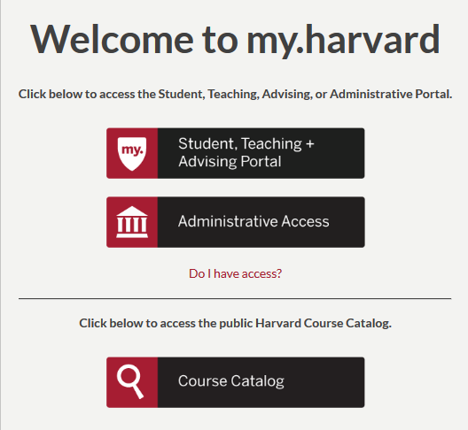
Log into my.harvard
portal.my.harvard.edu
Access student academic advising report

Slide 12
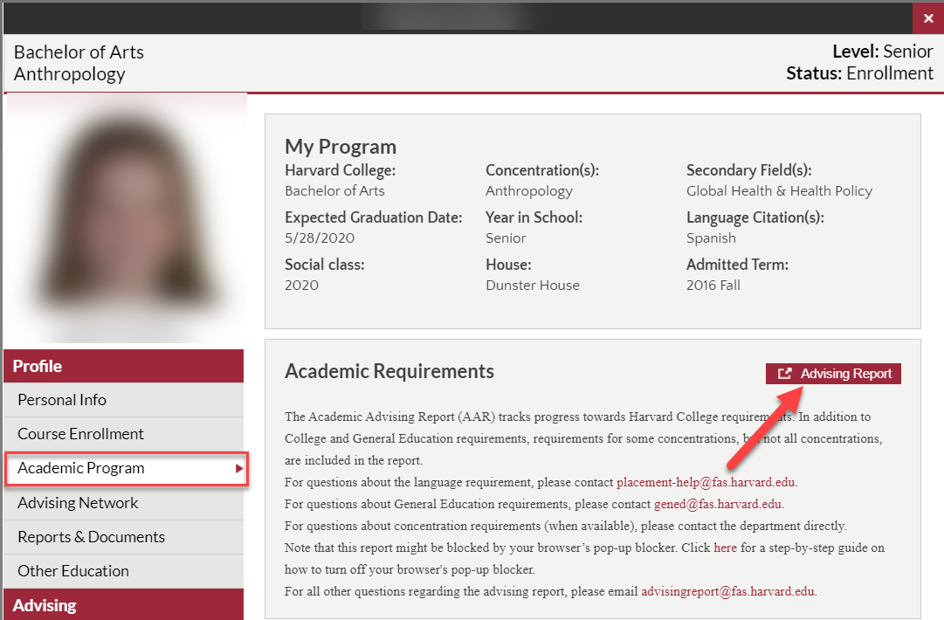
Academic Advising Report

Slide 13
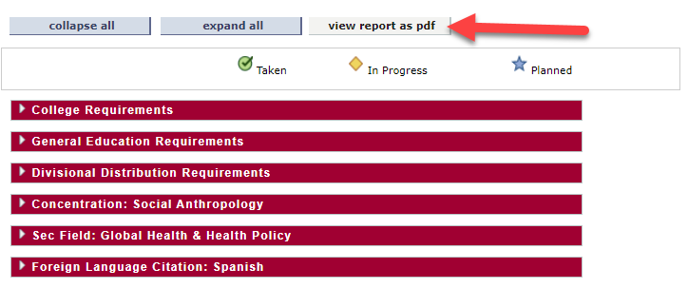
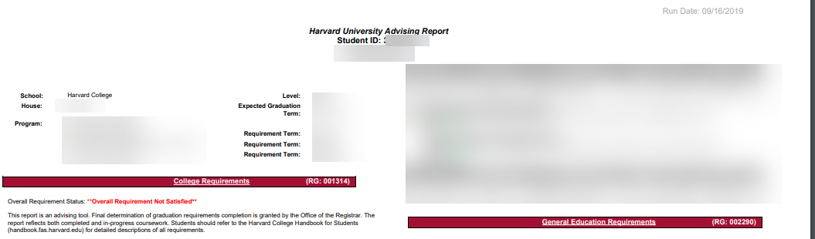
Academic Advising Report

Slide 14
1. Introduction: How can I use AARs?

Slide 15
How can I use AARs?
What can departments do?
Run advising reports
Enter exceptions
Update course lists
Run and download reports from HCOL concentration Workcenter.
What can advisors do?
Run advising reports
Enter exceptions*
Run and download reports from HCOL concentration Workcenter.
What can students do?
View and download advising reports
Request exceptions
Contact appropriate department or office regarding inaccuracies
What can faculty do?
View and download advising reports

Slide 16
2. Maintenance: Managing AARs

Slide 17
Managing AARs
Updates to
Requirements/
New track (subplan)
Course lists
Student groups/
Student exceptions
Registrar’s office
Registrar’s office/ Department
Department

Slide 18
2. Maintenance: Timeline

Slide 19
Timeline of AAR Maintenance
Time frame | Action
May | Faculty vote to approve classes in my.harvard Course Search
June | Update AAR course lists with new course offerings or email advising@fas.harvard.edu to update course lists.
June | Email requirement changes or new tracks (subplans) to advisingreport@fas.harvard.edu
July-August | Enter student exceptions & update student groups
September | Review AARs and make recommendations for November graduation candidates
March | Enter student exceptions & update student groups
April | Review AARs and make recommendations for May degree candidates

Slide 20
3. Resources: FASRO SharePoint

Slide 21

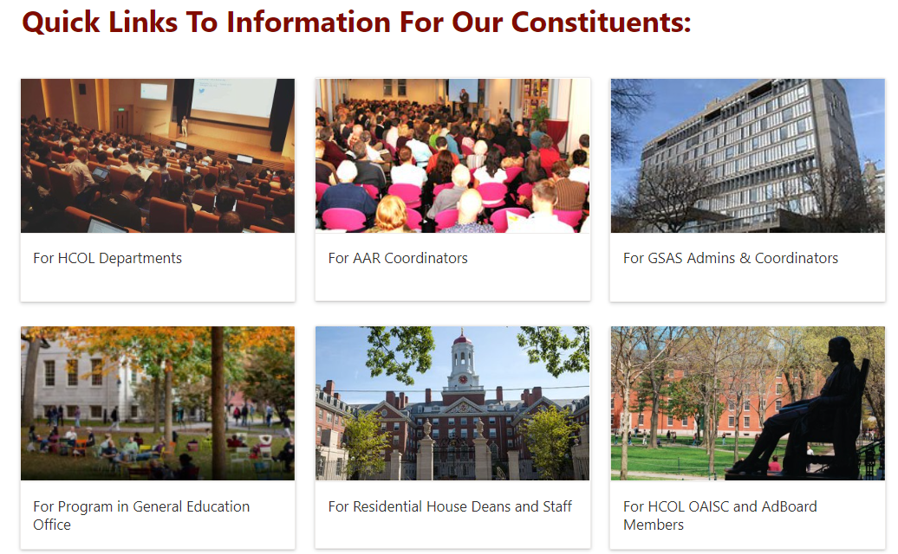

Slide 22
3. Resources: HCOL Concentration Workcenter

Slide 23
Log into my.harvard
admin.my.harvard.edu
Administrative access to academic advising reports

Slide 24
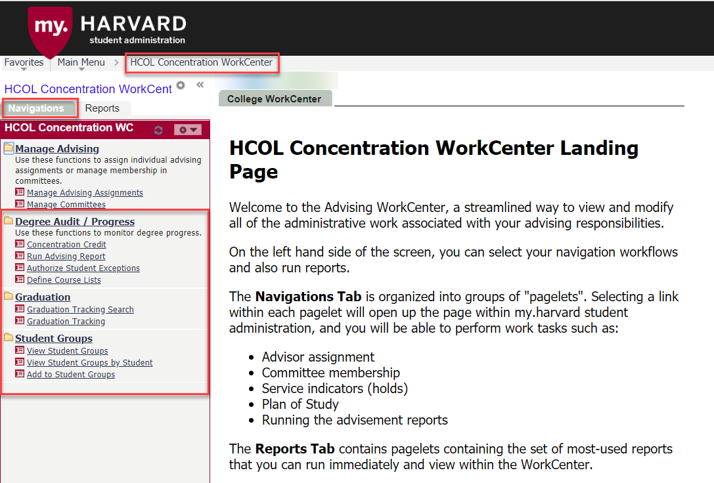
Make changes to AARs

Slide 25
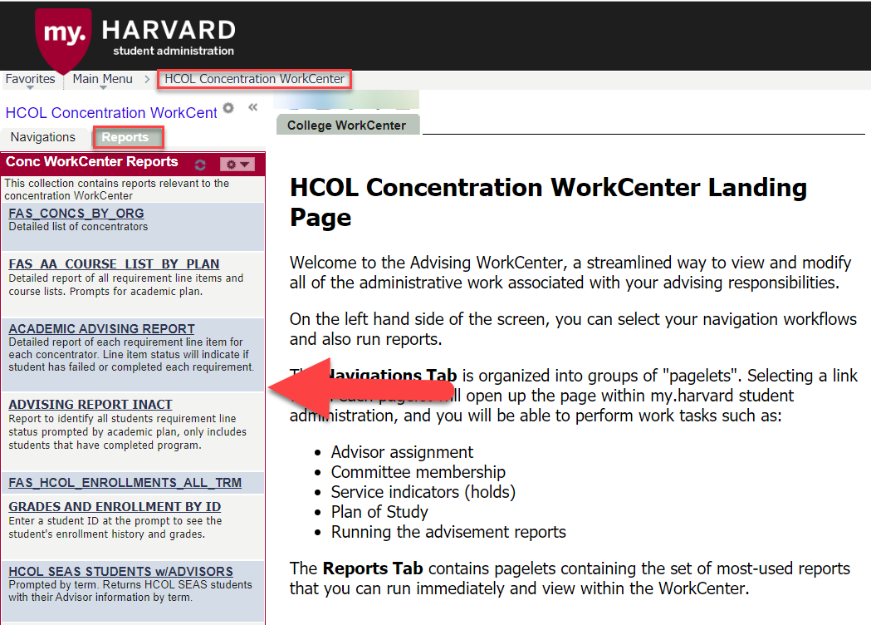
Data and Reporting

Slide 26
3. Resources: AAR Partners

Slide 27
Partners in AAR Management
Department | Requirements | Contact
General Education | General Education Distribution Requirement Quantitative Reasoning w/ Data | gened@fas.harvard.edu
Placement Office | Language Requirement | placement-help@fas.Harvard.edu
Departments | Concentration Secondary fields Language Citations
Registrar’s office | 128 credit requirement C- or better in 84/96 credits 48 credits by sophomore yr. Prorated credit requirements for transfer students or advanced standing | advisingreport@fas.harvard.edu
Notes:
Links to these tutorials can be found on the Catalog Coordinator page.

Slide 28

Questions???
Notes:
Links to these tutorials can be found on the Catalog Coordinator page.

